Slide 1
Computer System Engineering
Lab2: Multi-Threads
Contact:
dima_rabadi@mymail.sutd.edu.sg
jie_yang@mymail.sutd.edu.sg

Slide 2
Objectives
Implement multi-thread programs in Java/C
To understand how to sort an array in multi-thread, and compare the performance enhancement from using multi-thread

Slide 3
Tasks:
1. Find max value of an array using multi-thread
2. Sort an array using with multi-thread

Slide 4
Task 1: Finding maximum value
10 | 0 | 9 | 7 | 3 | 6 | 8 | 6 | 9
1. Split into 3 parts, create 3 threads
10 | 0 | 9
7 | 3 | 6
8 | 6 | 9
thread 1
thread 2
thread 3
2. Find max value in each thread
10
7
9
3. Find final max value from all sub-maximums
10

Slide 5
Task 2: Sort&Merge in multithread
10 | 0 | 9 | 7 | 3 | 6 | 8 | 6 | 9
1. Split into 3 parts, create 3 threads
10 | 0 | 9
7 | 3 | 6
8 | 6 | 9
thread 1
thread 2
thread 3
2. Sort each part in each thread
0 | 9 | 10
3 | 6 | 7
6 | 8 | 9
3. Merge all sorted lists together (multi thread?)
0 | 3 | 6 | 6 | 7 | 8 | 9 | 9 | 10

Slide 6
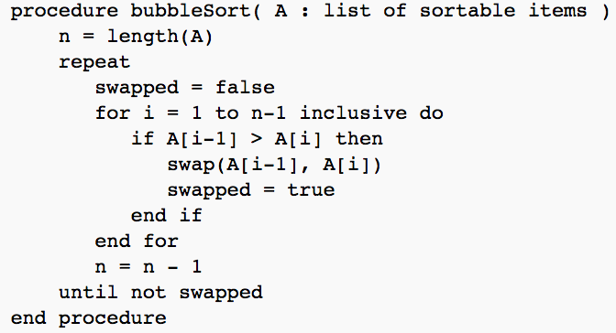
Task 2: Sort&Merge in multithread
Sort algorithm: bubble sorting as example
You can choose any sorting algorithm you want.
code from: https://en.wikipedia.org/wiki/Bubble_sort

Slide 7
Task 2: Sort&Merge in multithread
Merge algorithm: merge N sorted arrays
Solution 1: single thread
0. initialize cache array
Sorted sub arrays
1. select minimum value in cache array
cache
array
0 | 9 | 10
2. append the min value in target array
3 | 6 | 7
3. update cache array by replacing
minimum value with its right number
6 | 8 | 9
0

Slide 8
Task 2: Sort&Merge in multithread
Merge algorithm: merge N sorted arrays
Solution 2: multi thread
0 | 1 | 2 | 3 | 5 | 6 | 6 | 7 | 7 | 8 | 8 | 9 | 9 | 10
thread 1
0 | 1 | 2 | 3 | 6 | 6 | 7 | 8 | 9 | 9 | 10
thread 1
0 | 6 | 8 | 9 | 9 | 10
1 | 2 | 3 | 6 | 7 | 9
thread 1
thread 2
0 | 9 | 10
6 | 8 | 9
3 | 6 | 7
1 | 2 | 9
5 | 7 | 8

Slide 9
Task 2: Sort&Merge in multithread
Merge algorithm: merge N sorted arrays
Of course, we are not forcing you.
Other merge solutions are all permitted!
Pic from: http://www.1626.com/zixun/207148.html

Slide 10
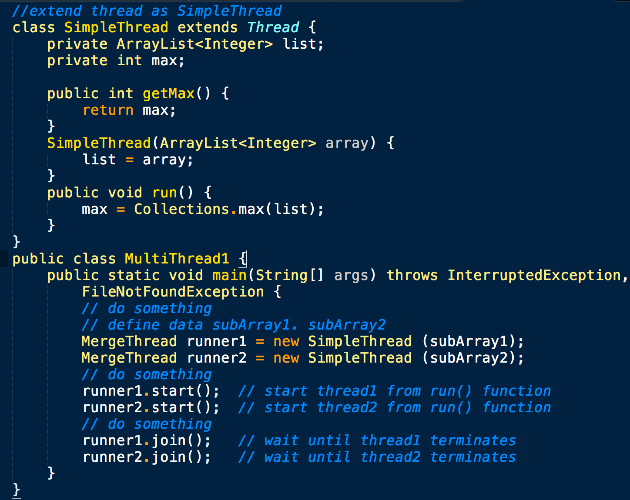
Code tips: multi-thread (Java)
Java example: inherit Thread and use it

Slide 11
Code tips: multi-thread (Java)
Java example: inherit Thread and use it
SimpleThread runner1 = new SimpleThread(subArray1);
// create a object for class SimpleThread
runner1.start(); // will start the thread in run() function
runner1.join(); //waits corresponding thread terminates

Slide 12
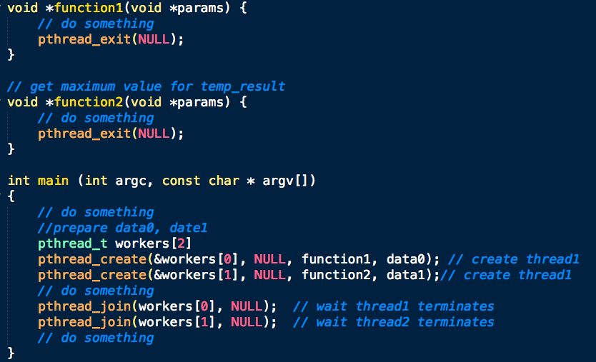
Code tips: multi-thread (C)
C example: how to use pthread

Slide 13
Code tips: multi-thread (C)
C example: how to use pthread
pthread_create(&workers[0], NULL, function1, data0); // create thread
pthread_exit(NULL); // terminate thread
pthread_join(workers[0], NULL); // wait until thread terminates

Slide 14
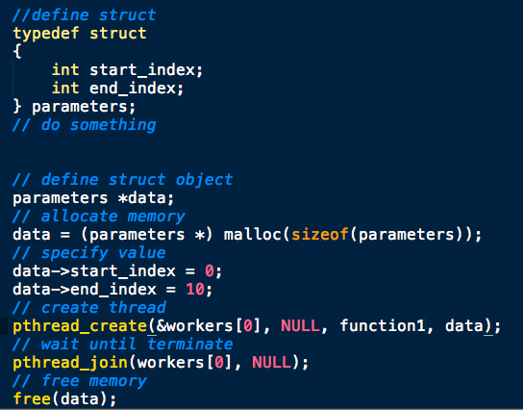
Code tips: multi-thread (C)
Problem:
pthread_create() only accept one parameter, how to pass multiple arguments?
Solution:
use struct

Slide 15
Let’s start!
For task 1:
1. Read data from “input_1.txt”, store the data in an array (array length =100).
2. Partition the array into N parts, and run N threads for finding max value
3. Print out the N max values.
4. Find the max value from the N max values.
5. Print out the max value (should be 99).

Slide 16
Let’s code!
For task 2:
1. Read data from “input_1.txt”, store the data in an array (array length =100).
2. Partition the array into N parts, and run N threads for merge sort
3. Combine the N sorted subarrays into one sorted array;
4. Print out the sorted array;
5. Record the execution time for the sorting part of your program;

Slide 17
Let’s start!
For task 2:
6. Read data from “input_2.txt” (array length = 500000), change the number of threads, record the execution time, and explain how execution time changes based on number of threads.
Number of threads | 1 | 2 | 5 | 10 | 20 | 50 | 100 | 200 | 500 | 1000 | 2000
Execution time (ms)

Slide 18
Requirement
Submit your codes and description file at eDimension before 23:59 at 9th February (Tuesday) 2016 !
Remember adding your name and student ID in your submitted file.

